Slide 1
Rule Execution Services
Running Rules as a REST Service with InRule

Slide 2
InRule Rule Services…
Is a reference architecture for providing WCF REST services for rule execution.
This solution contains the following projects:
RuleServices - Rule Execution Services operations include: ApplyRules (Get), ExecuteRuleSet (Get), ExecuteRuleSet (Post)
HTMLTestUI - Simple html test page. Construct Rule Service request xml and execute request from javascript.
ASPMVCTestUI - Demonstrates calling Rule Services via ASP MVC using a Service Reference.

Slide 3
Services Overview
Service Operations for both Get and Post
Simple Uri based or rich proxy
Variable response types
Work with “as is” or modify as needed
Prerequisites:
.NET 4.0 (using WCF)
Visual Studio 2012/2013
ASP.NET MVC 4 (for MVC demo only)
InRule 4.5 or later
irCatalog (needed for sample rule app execution)

Slide 4
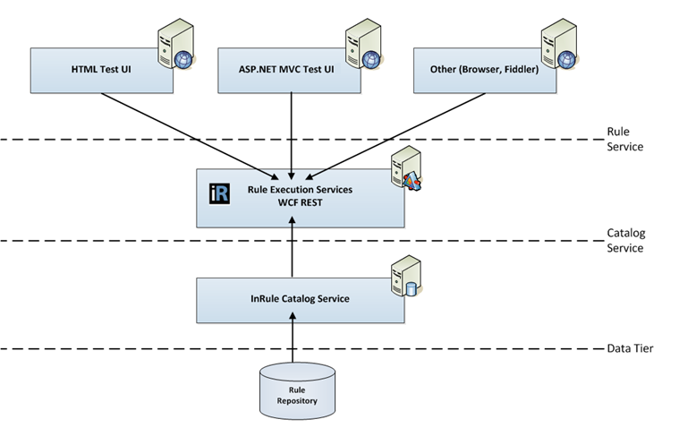
Architecture

Slide 5
REST Service Operations
ApplyRules (GET)
Runs auto firing rules
Returns System.IO.Stream (variable return type)
ExecuteRuleSet (GET)
Runs explicit or independent rule sets
Accepts parameters
Returns System.IO.Stream (variable return type)
ExecuteRuleRequest (POST)
Can be used to run auto, explicit or independent rule sets
Accepts parameters
Returns RuleExecutionResponse object

Slide 6
Simple URI Request (Get)
http://localhost:50001/InRule.RuleServices/RuleExecutionService.svc/ApplyRules?
ruleApp=RectangleApp&
entity=Rectangle&
entityXml=<Rectangle><Height>51</Height><Width>20</Width></Rectangle>&
returnEntity=Rectangle&
responseType=RuleExecutionReport
Build URI request string
Provide named querystring parameters
Response content type is text/xml or text/html based on requested responseType

Slide 7
RuleExecutionRequest
Public RuleServices interface to pass in execution directives and state
RuleApp
RuleSet
Parameters
Entity
Entity XML
Return Entity
ReturnType

Slide 8
RuleExecutionResponse
Used to return requested response(s)
Response types include
EntityXml
NotificationXml
ValidationsXml
ExecutionLogXml
RuleExecutionResponseXml (all of the above)
NotificationsText
ValidationsText
ExecutionLogText
PerformanceStatisticsReport
RuleExecutionReport

Slide 9
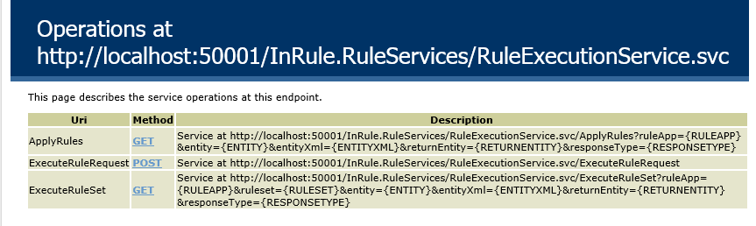
WCF Auto Help Enabled
<behavior name="webBehavior">
<webHttp helpEnabled="true" defaultOutgoingResponseFormat="Xml" automaticFormatSelectionEnabled="true"/>
</behavior>
WCF Generated help page at ../InRule.RuleServices/RuleExecutionService.svc/help
Shows available web service operations and parameters

Slide 10
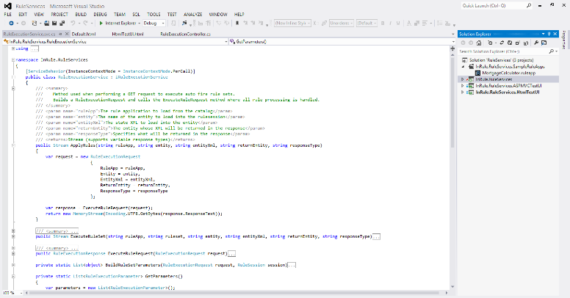
Solution setup
Visual Studio 2012/2013
.NET 4.0
InRule references
InRule.Runtime
InRule.Repository

Slide 11
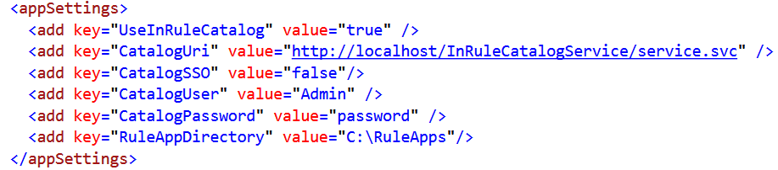
Configuration Notes:
InRule.RuleServices.csproj is configured to start at - http://localhost:50001/InRule.RuleServices/RuleExecutionService.svc/
InRule.HtmlTestUI.csproj is configured to start at - http://localhost:50003/
InRule.ASPMVCTestUI.csproj is configured to start at - http://localhost:50002/
For SOAP - uncomment SOAP behavior section Web.config, minor service interface and caller changes
irCatalog Configuration - project points to local IIS service - (default Username 'admin' and Password 'password')
To change irCatalog configuration; update Web.config under InRule.RuleServices project.
Excerpt from web.config in RuleServices project

Slide 12
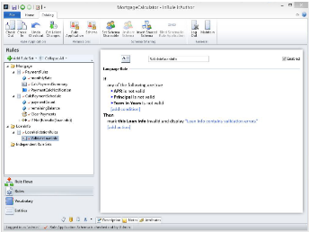
Sample Rule Application
Perform a Complete local install of InRule including irCatalog (see InRule Installation Guide)
Launch irAuthor (Start --> All Programs --> InRule --> irAuthor)
Open sample rule application (Download Location/Rule Service/RuleServices45/InRule.RuleServices.SampleRuleApps/MortgageCalculator.ruleapp)
Save rule application to irCatalog (File --> Save As --> Save to Catalog --> Click 'OK')
Sample entity structure, rules, calculations and collections.
Location: //InRule.RuleServices.SampleRuleApps/MortgageCalculator.ruleapp

Slide 13
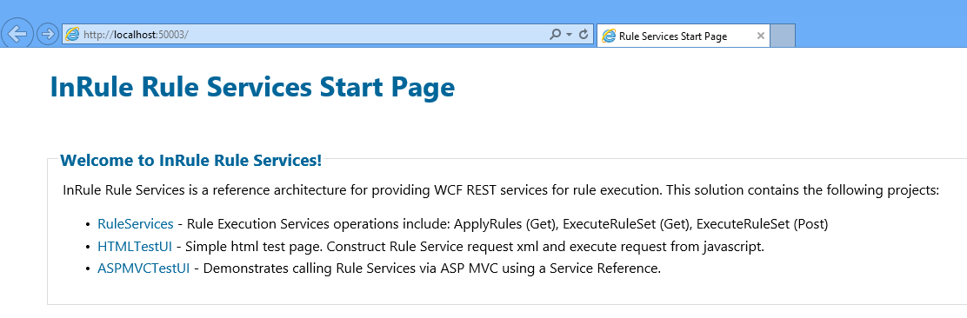
Testing Rule Execution Services
Launch Visual Studio 2012/2013
Open RuleServices Solution (Download Location/Rule Service/RuleServices45/RulesServices.sln)
Rebuild Solution (Important to re-compile all projects against installed InRule dlls)
Run the RuleServices solution - (InRule.RuleServices.HtmlTestUI should be set as StartUp Project)
The following projects will start: RuleServcies, HTMLTestUI, ASPMVCTestUI
StartPage (default.html) will launch in browser
Test Rule Services by clicking on either the HTMLTestUI or ASPMVCTestUI
Optional: Test Rule Services from another client (direct in browser, fiddler, etc.)
Debug - set project to debug as StartUp Project or Attach to Process

Slide 14
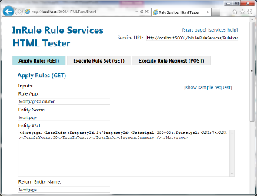
Calling from Html/Javascript
jshelpers.js
Use XMLHttpRequest object
Other
JQuery or favorite AJAX based service approach
Execution request called from client

Slide 15
Calling from ASP.NET MVC
RuleExecutionController demonstrates two approaches with RuleClient class:
RuleClient proxy UploadData
used for POST
bind View to RuleExecutionRequest model
RuleClient proxy DownloadString
used for GET, no service reference, no view binding
Execution request called server side, RuleClient inherits from .NET WebClient class

Slide 16
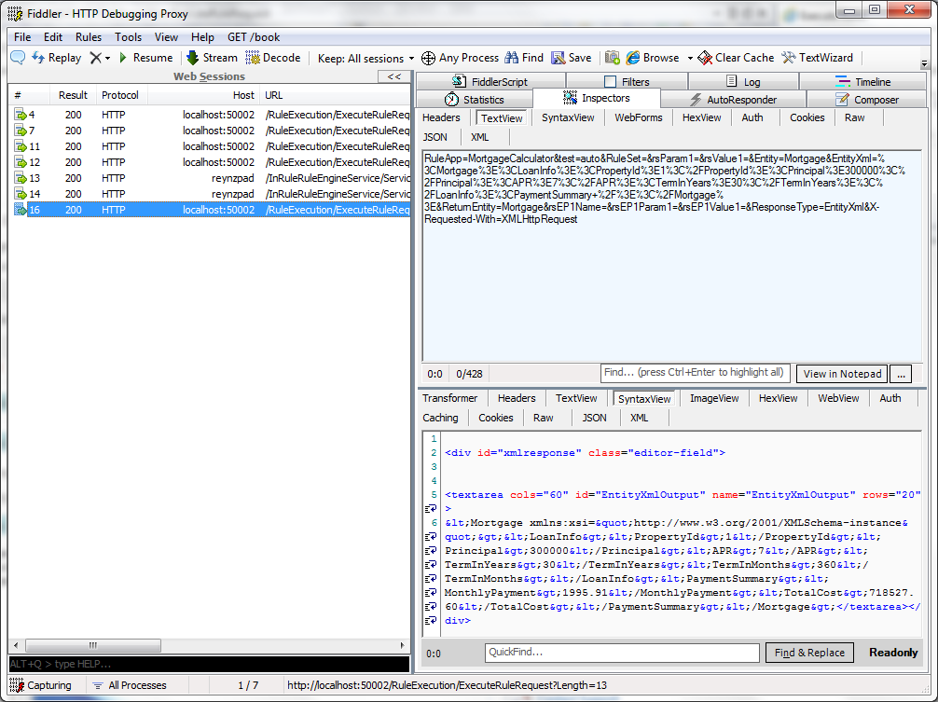
Other ways to test
Direct from browser
Fiddler
Other

Slide 17

Switching to SOAP
Modify service web.config to use SOAP service behavior configuration instead of REST (already there, just uncomment)
Change method interface in IRuleExecutionService.cs from WebInvoke to OperationContract
Change ResponseContentType in RuleServiceHelper.cs from text/xml to application/soap+xml
For MVC, use a VS Service Reference to generate a proxy

Slide 18

Questions
Future Considerations
Catalog metadata
OData integration
JSON Support
Contact Us – ROAD@inrule.com

